Slide 1
Revelation - Intro
By Richard Osei
Ref. Chuck Missler

Slide 2
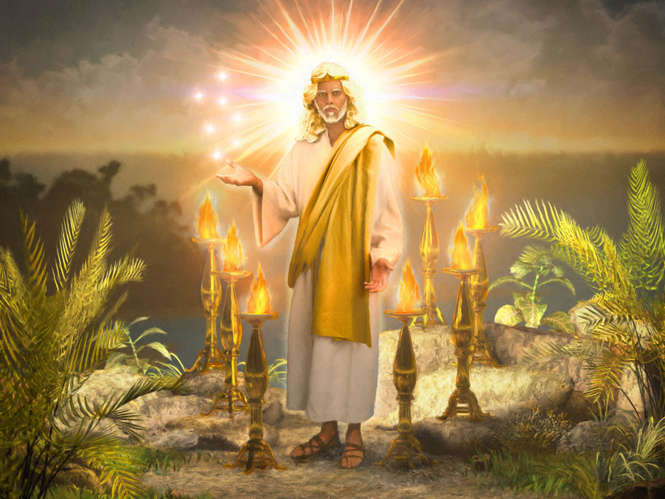

Slide 3
Revelation – Introduction
Revelation is – is Singular, not plural
Revelation – to unveil or uncover, to reveal
Revelation contain seven Epistles by Jesus:
Ephesus
Smyrna
Pergamos
Thyatira
Sardis
Philadelphia
Laodicea
“Search the Scriptures and they are they which testify me” John 5:39

Slide 4
Whole Counsel of God
Christ at the Center (Rev 1:1)
“More sure word of prophecy” 2 Pet. 1:19
“Search the Scriptures and they are they which testify me” John 5:39
“Volume of the book is written of me” Ps. 40:7
Testimony of Jesus is the spirit of prophecy” Rev. 19:10
“Thy Kingdom Come” Matt. 6:10

Slide 5
Revelation (The Unveiling)
The Consummation of all things
The only book promising a special blessing to the reader (Rev. 1:3)
The only book in the Bible with an outline
Things thou has seen (the vision of Christ) – Rev. 1:19
The things which are (the present churches - letters) - Rev. 1:12-18
The things which shall be hereafter (the prophecy) – Rev. 4-22
404 verses containing over 800 allusions from the Old Testament
It presents the climax of God’s Plan for Man

Slide 6
Bible Overview
Old Testament Christ in Prophecy | “Behold, He Comes!”
Gospels Christ in History | “Behold, He Dies!”
Acts Christ in the Church | “Behold, He Lives!”
Epistles Christ in Experience | “Behold, He Saves!”
Apocalypse Christ in coming Glory | “Behold, He Reigns!”

Slide 7
Bible Overview
Two Basic Discoveries
The Bible consist of 66 separate book
Penned by over 40 authors
Over a period of several thousand years that are in integrated message system;
It can be demonstrated that the origin of this message is from outside of our dimension of space and time

Slide 8
Bible Overview
The OT is an account of a Nation.
The NT is the account of a Man
The creator became a Man. His appearance is the Central Event of all History
He died to purchase us and is alive now
The most exalted privilege is to know Him. That’s what the Bible is all about.

Slide 9
Revelation
God means what He says and says what He means
Nothing is trivial: All things are for our learning
God is His own interpreter
Search Scriptures yourself - Act 17:11

Slide 10
John - the Author
The Gospel of John
Three Epistles
1 John - Sermon on Love
2 John - Personal letter to Mary?
3 John – Personal note to Gaius
The Apocalypse (Revelation)

Slide 11
John - the Author
Born at Bethsaida to Zebedee and Salome
Galilean fisherman
In partners with Peter and Andrew
Early disciple of John the Baptist
Well connected
High Priest, Nicodemus, et al (John 18:15)?
One of the inner circle
Mt. Transfiguration (Matt. 17) Peter, James and John
Raising of Jairus’ daughter (Matt:18)
Olivet Discourse (Matt. 24)
Gethsemane (Matt. 26.37)
Assigned care of Mary (John 19:26)

Slide 12
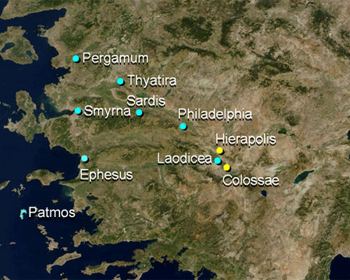
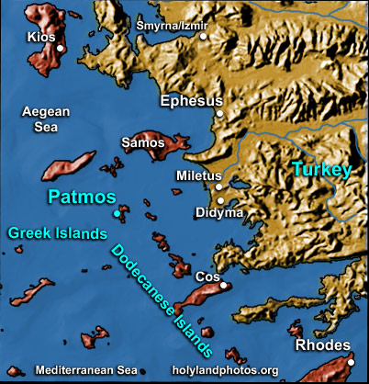
John - the Author
Ultimately retires to Ephesus after his exile (81-96 AD)

Slide 13
The Patmos Exile
Exiled by Domitian (81-96 AD) the brother of Titus who destroyed Jerusalem in 70 AD.
History
Hippolytus:
John was first plunged into a boiling oil, and then sent to this island exile
Victorinus:
John was forced to work in the mines that were located on Patmos
Irenaeus, Clement, and Eusebius:
After Domitian dies, John returned to Ephesus, went to the churches, and appointed leaders, and set things in order

Slide 14
Revelation - Alternative Views
Preterism - Then One (apply to the first century)
Historical - History only
Idealist - Allegorical (not real, Jesus is in the heart)
Futurist - Prophetic
Why Prophecy
Old Testament
1845 references to Christ’s rule on the earth
17 OT books give prominence to the event
New Testament
Of the 216 chapters, there are 318 references to the Second Coming
It is mentioned in 23 of the 27 books

Slide 15
The Sevens
Seven Churches (1:4, 11,20; 2; 3)
Seven Seals (5; 6)
Seven Trumpets (8,9)
Seven Bowls (15; 16; 17:1; 21:9)
Seven Plagues (15:1,6,8; 21:9)
Seven Mountains (17:9)
Seven Kings (17:10,11)

Slide 16
The Sevens
Seven Lampstands (1:12-13,20; 2:1)
Seven Spirits (1:4; 3:1; 4:5; 5:6)
Seven Stars (1:16,20; 2:1; 3:1)
Seven lamps (4; 5)
Seven “Title-pairs” (2; 3)
Seven Promises to the Overcomer (2; 3)
Seven Horns (5:6)
Seven Eyes (5:6)
Seven Angels (8:2,6; 15:1,6-8; 16:1; 17:1; 21:9)
Seven Thunders (10:3, 4)
Seven Thousand (11:13)
Seven Heads (12:3; 13:1 17:3, 7, 9)
Seven Crowns (12:3)

Slide 17
The Sevens - Beatitudes
1. Blessed I he that readeth, and they that hear and keep those things … (1:3)
2. Blessed are the dead who die in the lord (14:13)
3. Blessed is he that watcheth and keepeth his garments (16:15)
4. Blessed are they who are called unto the marriage supper of the Lamb (19:9)
5. Blessed and holy is he that hath part in the first resurrection (20:6)
6. Blessed is he that keepeth the words of the prophecy of this book
7. Blessed are those who do His commandments (22:14)

Slide 18
The Sevens
Seven Features (1)
Seven Letter Divisions (2; 3)
Seven Personages
Woman, Man-Child, Red Dragon, 7 headed Beast, False Prophet, Michael, Lamb
Seven Years of Judgments (11:3; 12:6,14; 13:5)
Seven “I Am’s” of Christ (1:18, 17, 18; 21:6; 22:13,16)
Seven Doxologies in heaven (4:9-11; 5:8-13; 7:9-12; 11:16-18; 14:2-3 15:2-4 19:1-6)
Seven New Things (20:21)
……

Slide 19
Revelation - The Climax of Everything
Genesis | Revelation
Earth Created (1:1) | Earth Passed away (21:1)
Sun to govern Day (1:16) | No need of sun (21:23)
Darkness called night (1:15) | No night there (22:5)
Waters He called seas (1:10) | No more sea (21:1)
A river for earth’s blessing (2:10-14) | A river for New Earth (22:1,2)
Earth’s government (re: Israel) (37) | Earth’s judgment (re: Israel) (16:8)
Man in God’s Image (1:26) | Man Headed by Satan’s Image (13)
Entrance of sin (3:6) | End of sin (21:27)
Curse pronounced (3:14-17) | No more curse (22:3)
Death entered (3:19) | No more death (21:4)
Man driven out of Eden (3:24) | Man restored (22)
Tree of life guarded (3:23) | Right to Tree of life (22:14)
Sorrow & suffering enter (3:17) | No more sorrow (22:4)
Nimrod founds Babylon (10:8-10) | Babylon falls (17,18)
God’s Flood to destroy evil generation (6-9) | Satan’s flood to destroy elect generation (2)
A bow: God’s promise (9:13) | A bow for remembrance (4:3; 10:1)
Sodom & Egypt: corruption, judgment (13,19) | “Sodom & Egypt” (Jerusalem) (11:8)
A confederation vs. Abraham’s people (14) | A confederation vs. Abraham’s seed (12)
A bride for Abraham’s son (24) | A bride for Abraham’s Seed (21)
Marriage of 1st Adam (2:18-23) | Marriage of Last Adam (19)
Man’s dominion ceased; Satan’s begun (3:24) | Satan’s domain ended man’s restored (22)

Slide 20
Outline of chapter 1
1-3 - Introduction
4-11 - Salutation & Occasion
12-18 - Vision of the Risen Christ
19 - Online of the Book
20 - Prep for Chapters 2 and 3

